Slide 1
Academic Review A dive into the effects of different variables on student performance in US Public Schools
Paper Straws. LLC
Notes:
mw

Slide 2

Motivation
NFL → Radiation → Books → Plastic Waste → Education
Background: The team decided on Education due to the numerous and robust datasets available, and less so due to personal interest in the topic.
Reasoning:
Discoursed topic
Relatable topic
Digestible topic
Enrollment in GT bootcamp
David’s kids
Notes:
mw

Slide 3
Core Questions and Hypotheses
Is student performance* in the US affected by student:teacher ratio?
Is student performance* in the US affected by teacher salary?
Is student performance* in the US affected by school financials?
Is student performance* in the US affected by per student spending?
How do these findings differ by state?
Null hypotheses (Ho): Student:teacher ratio does not have an effect on student performance
Null hypotheses (Ho): Teacher salary does not have an effect on student performance
Null hypotheses (Ho): School financials do not have an effect on student performance
*”Student performance” defined as High School graduation rate
Notes:
sean

Slide 4

Discovery and Analysis

Slide 5

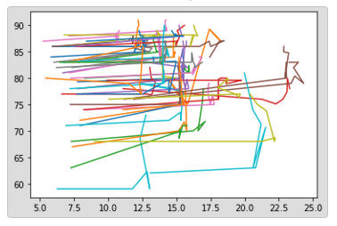

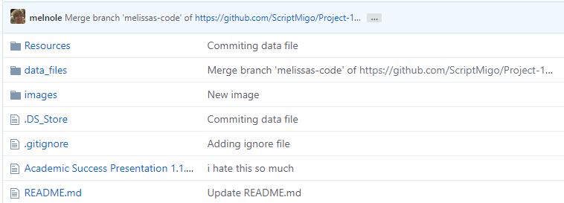
Our Process
Notes:
Saurin

Slide 6

Discovery and Data Sources
Google
Kaggle
US Department of Education
US Department of Labor
National Center for Education Statistics (NCES)
National Education Association (NEA)
Census
Our Brains!
Notes:
Sean

Slide 7
Data Cleanup
Get pic of team hanging out with coffee, in a bar ,whatever
Deep dive into datafiles
Re-defined parameters
Re-established metrics
Pic of saurin working on laptop v concentrated
Notes:
Saurin

Slide 8
Data Analysis
Review datasets
Discuss strategy
Brainstorm visualizations
Manipulate data real-time
Determine charts and chart types for presentation
Identify data for statistical analysis requirement
Analyze data and visualizations, uncover findings
Notes:
Saurin

Slide 9
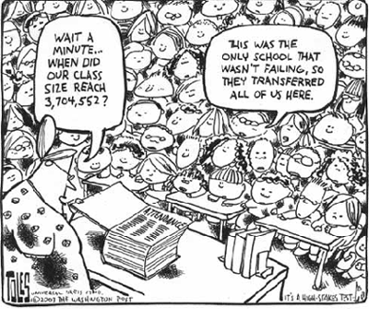
Findings

Slide 10
Key Findings

Slide 11
Aggregate Findings
Saurin: math and reading us*
Sean: grad rates v student teacher ratio us
grad rates v teacher salary us
grad rates v school financials us
Saurin: student:teacher ratio us
teacher salary us
school financials us
Per student spending?*

Slide 12
Granular Findings
Saurin: student teacher ratio by state
teacher salary by state
school financials
Sean: grad rates v student teacher ratio by state
grad rates v teacher salary by state
grad rates v school financials by state

Slide 13
Georgia Findings
melissa:
*math and reading ga and region
grad rates v student teacher ratio ga
grad rates v teacher salary by state ga
grad rates v school financials by state ga
Scott: ANOVA ga vs US, vs SE
.describe on GA

Slide 14

Implications

Slide 15
Implications
Discuss the implications of your findings. This is where you get to have an open-ended discussion about what your findings "mean".

Slide 16

Appendix

Slide 17
https://www.gadoe.org/External-Affairs-and-Policy/communications/Pages/PressReleaseDetails.aspx?PressView=default&pid=395
About 57m students attended elementary, middle, and high schools across the US in 2019
Highest enrollment ever reported for public schools
3.7m teachers 2019
source: https://nces.ed.gov/fastfacts/display.asp?id=372

